Slide 1

CV1711 ENGINEERING DRAWING & 3D BUILD INFO MODEL (LAB)

Slide 2
Instructor Information
NAME: CUI SHUAIWEN (SHAUN)
EMAIL: SHUAIWEN001@e.ntu.edu.sg
TEL: 83071903
Any questions? Feel free to reach out!

Slide 3
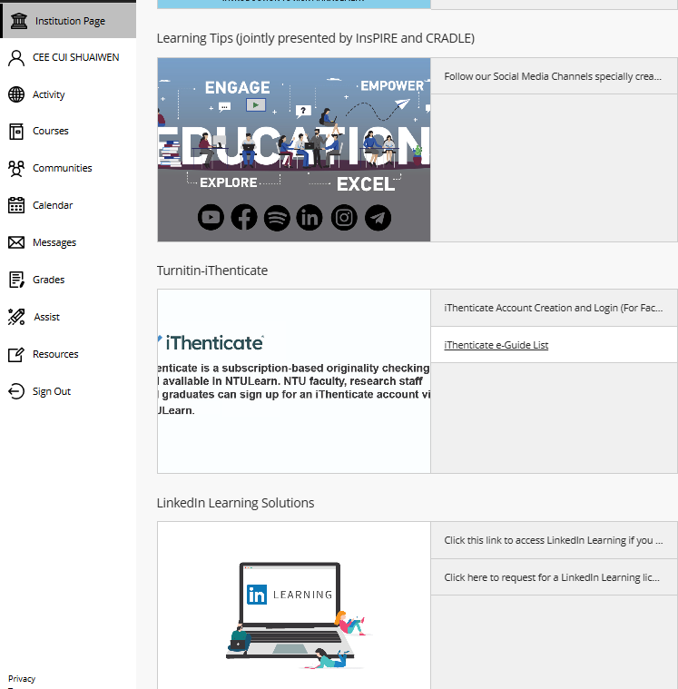
WEEK 1 & 2 – CAD Basics
Learn AutoCAD basics on NTULearn
Submit E2 by the end of week 2
After that, move on to week 3, 4, …
Linkedin Video Access Issue?
Mark your attendance before leaving
Save files & sign out before leaving
Any questions? Feel free to reach out

Slide 4
WEEK 3 – CAD Basics
Follow the instructions and videos on NTULearn
Submit E3 & E5 by the end of week 3
After that, move on to week 4 (orthographic projection), week 5 (auxiliary projection), week 6 … much more difficult, please preview the material before class.
Mark your attendance at the end of class
Save files & sign out before leaving
Any questions? Feel free to reach out

Slide 5

WEEK 4 – Orthographic Projection
Let’s watch this youtube video for basic understandings.
https://youtu.be/heIobpUVZqc?si=No0iEweG8M1roWwM

Slide 6
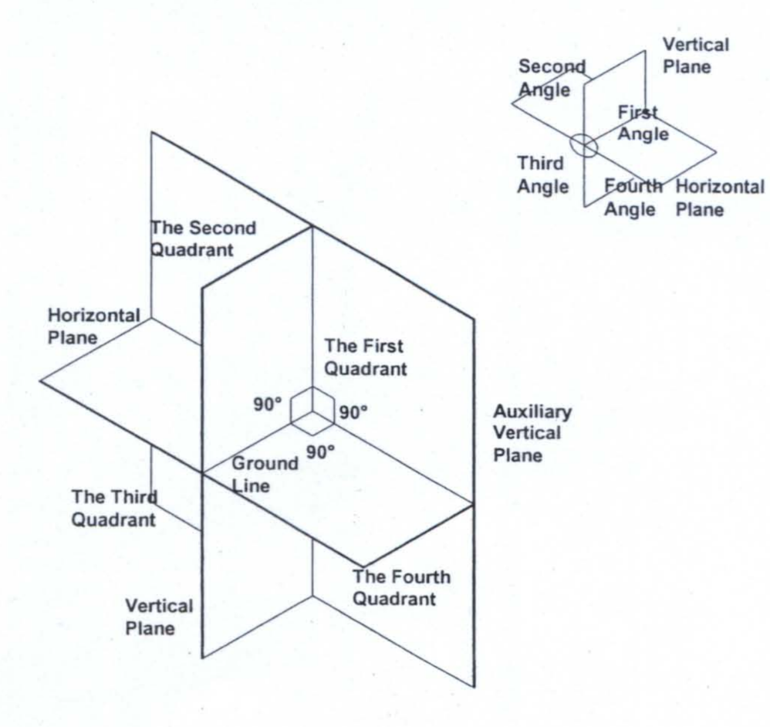

Quadrant System and Orthographic Projection
First Angle Projection
Third Angle Projection

Slide 7

Quadrant System and Orthographic Projection
First Angle Projection
Third Angle Projection
The Projection is behind the object.
The Projection is in front of the object.

Slide 8
First-angle projection:
T = elevation / front
S = end / side
P = plan / top
Unfold such that elevation view is adjacent to / center of other views.
First-angle projections are behind the object.
P
End 1
Elevation
End 2
Base
S2
Vertical partition
Lid
Vertical partition
Base
Horizontal partition
Horizontal partition
Plan
Lid
S1
T
Elevation is always on the vertical partition of the box.
Plan is always on the horizontal partition of the box.

Slide 9
First-angle projection:
Comment:
Notice that P may not be given, because plan view is always from above.
Variation 1
S
T
Not required
Lid
Vertical partition
Base
Horizontal partition
S
T

Slide 10
First-angle projection:
Variation 2
Comment:
The object is rotated.
Comment:
The layout stays the same because the object is simply rotated.
Not required
S
T
Lid
Vertical partition
Base
Horizontal partition
S
T

Slide 11
First-angle projection:
Comment:
The other end view is requested.
Variation 3
Comment:
Take note that the layout is different now. Because first-angle projections are behind the object.
Take note of the hidden line.
S
T
Not required
Lid
Vertical partition
Base
S
Horizontal partition
T

Slide 12
First-angle projection:
Comment:
The other end view is requested.
Comment:
Take note that the layout is different now. Because first-angle projections are behind the object.
Take note of the hidden line.
Variation 4
S
T
Not required
Lid
Vertical partition
Base
Horizontal partition
S
T

Slide 13
Third-angle projection:
T = elevation / front
S = end / side
P = plan / top
Unfold such that elevation view is adjacent to / center of other views.
Third-angle projections are in between the object and the viewer / in front of the object.
P
Plan
Horizontal partition
Base
S2
Horizontal partition
Lid
Vertical partition
Base
Vertical partition
End 1
Elevation
End 2
Lid
S1
T
Elevation is always on the vertical partition of the box.
Plan is always on the horizontal partition of the box.
Same as first-angle, even the locations of End 1 and End 2.

Slide 14
Third-angle projection:
Comment:
Remember, projections are in front of the object for the third angle.
Comment:
Notice that P may not be given, because plan view is always from above.
Variation 1
T
S
Horizontal partition
Lid
Vertical partition
Base
Not required
S
T

Slide 15
Third-angle projection:
Variation 2
Comment:
The object is rotated.
Comment:
The layout stays the same because the object is simply rotated.
T
S
Horizontal partition
Lid
Vertical partition
Base
Not required
S
T

Slide 16
Third-angle projection:
Variation 3
Comment:
Take note that the layout is different now. Third-angle projections are in front of the object.
Take note of the hidden line.
S
Comment:
The other end view is requested.
T
S
Horizontal partition
Lid
Vertical partition
Base
Not required
T

Slide 17
Third-angle projection:
Variation 4
Comment:
The final drawings are the same as Variation 1.
S
Comment:
The elevation view of the question has changed.
T
Horizontal partition
Lid
Vertical partition
Base
Not required
S
T

Slide 18


SCAN TO DOWNLOAD THE SLIDES

Slide 19
WEEK 4 – Orthographic Projection
First Quadrant
Plan is always below elevation
Project the view at the back of project
Plan is always above elevation
Project the view in front of the object plane
Third Quadrant
Direction T
Elevation View (first to draw)
Direction S
End of View
Distance from Horizontal & Vertical Plan must be equal for projecting points, lines &surface measurements from one view to another views
https://www.youtube.com/watch?v=heIobpUVZqc

Slide 20
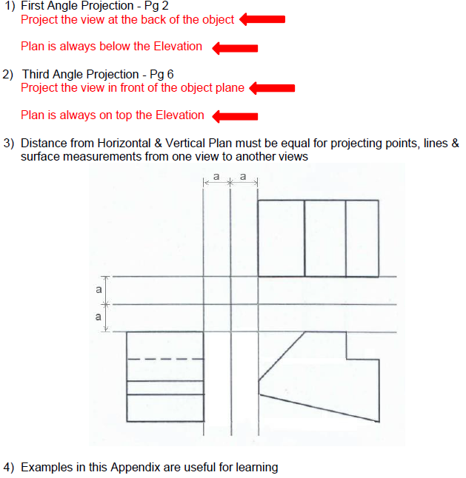
WEEK 4 – Orthographic Projection

Slide 21
WEEK 5 – Auxiliary Projection
Very Import, Please Pay Close Attention!

Slide 22
WEEK 5 – Auxiliary Projection – Recap
First Angle Projection
Third Angle Projection

Slide 23
WEEK 5 – Auxiliary Projection – Terms
First (Primary) Auxiliary Projection: A view projected onto a plane that is perpendicular to one principal view, used to show an inclined surface in its true size and shape.
First / Primary: The projection obtained by rotating once from a principal view (front, top, or side). Not First Quadrant.

Slide 24
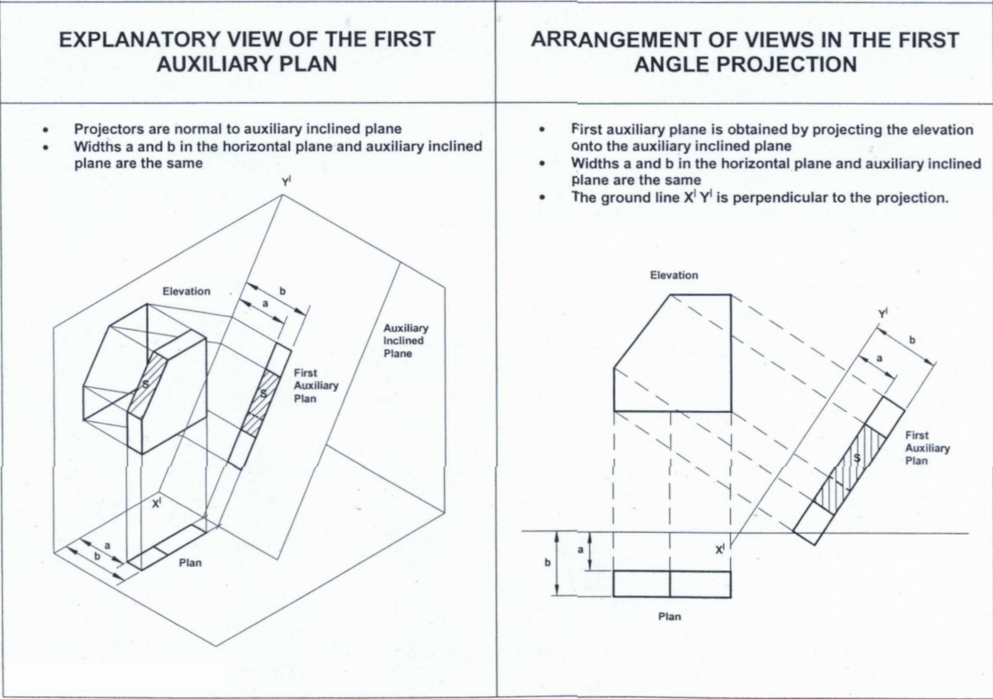
WEEK 5 – Auxiliary Projection – Auxiliary Plan
Some Kind of Plan:
– More Like Plan
– Perpendicular to Elevation View

Slide 25
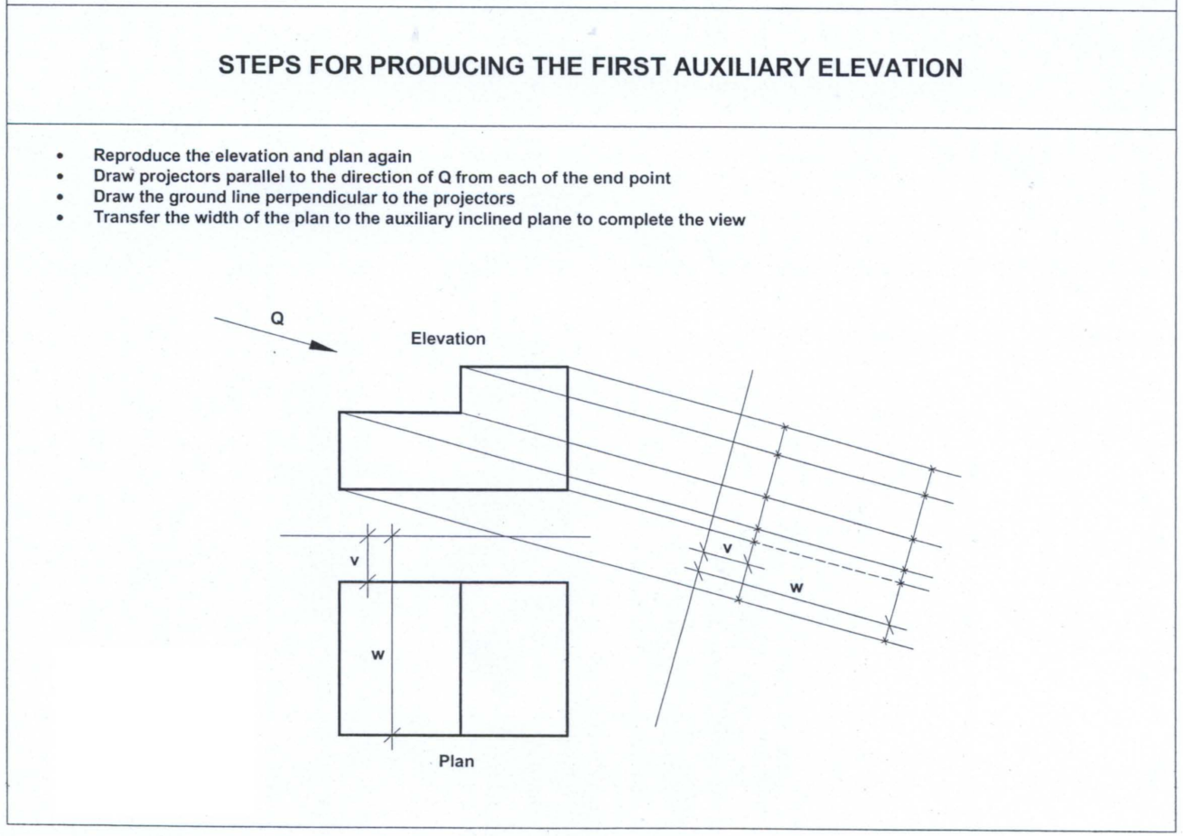
PLAN

Slide 26
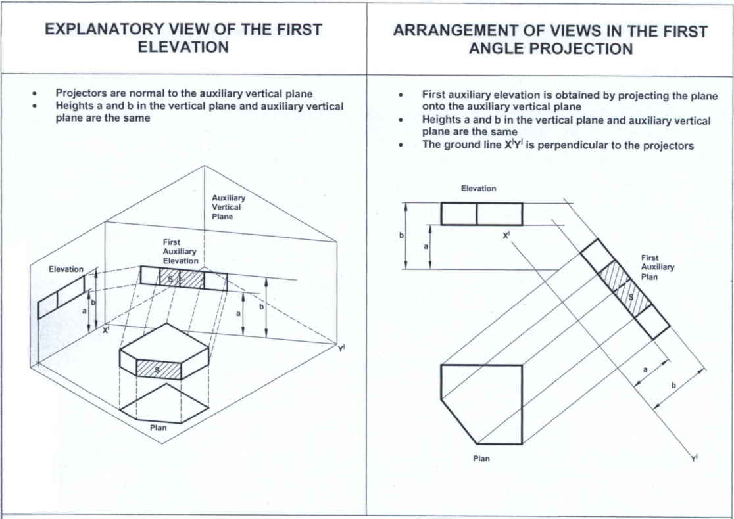
WEEK 5 – Auxiliary Projection – Auxiliary Elevation
Some Kind of Elevation:
– More Like Elevation
– Perpendicular to Plan View

Slide 27
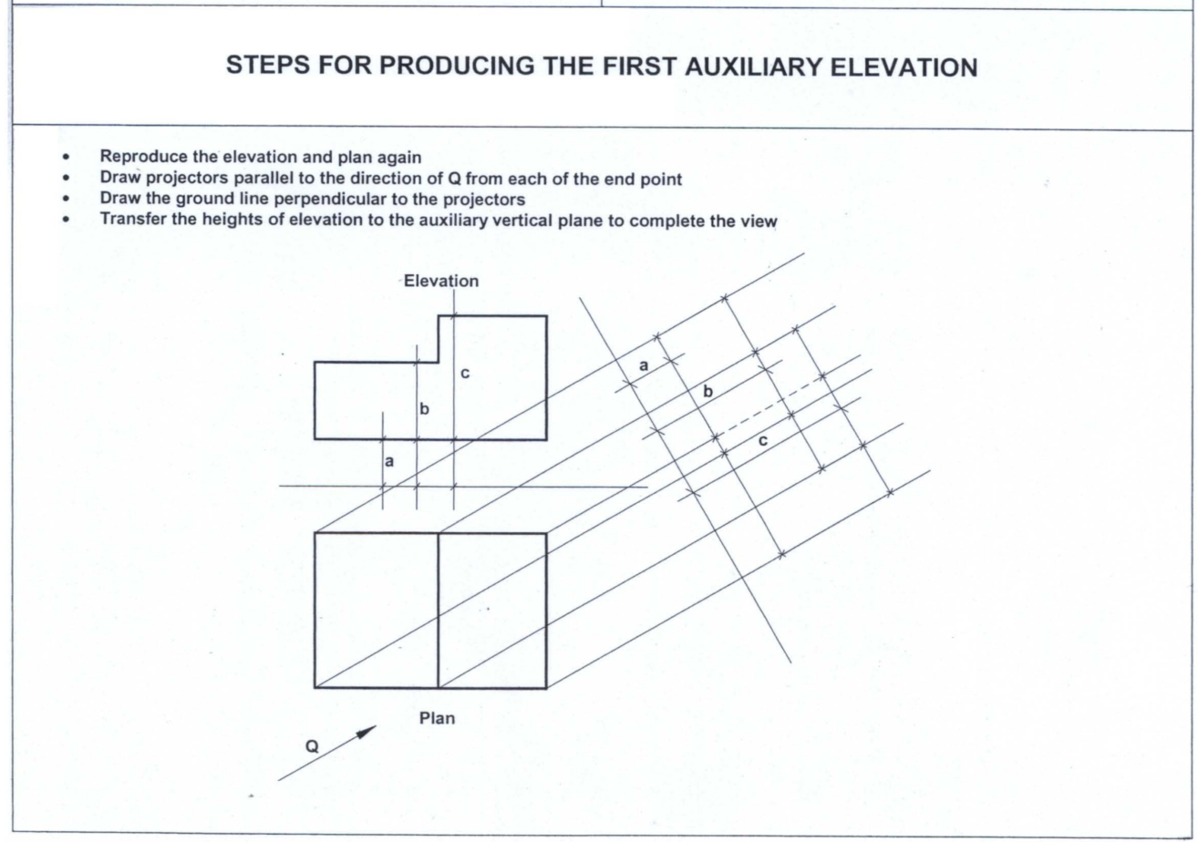
WEEK 5 – Auxiliary Projection

Slide 28
WEEK 5 – Auxiliary Projection
First Quadrant (Angle)
Auxiliary Plan
Third Quadrant (Angle)
Auxiliary Elevation

Slide 29
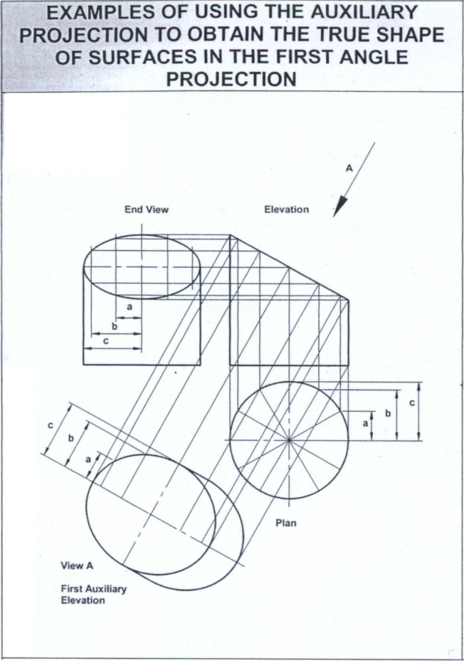
Example
- First Angle
- First Auxiliary Plan
Features:
- Projection behind the Object
- Perpendicular to Elevation View Projection

Slide 30
Example
- First Angle
- First Auxiliary Elevation
Features:
- Projection behind the Object
- Perpendicular to Plan View Projection

Slide 31
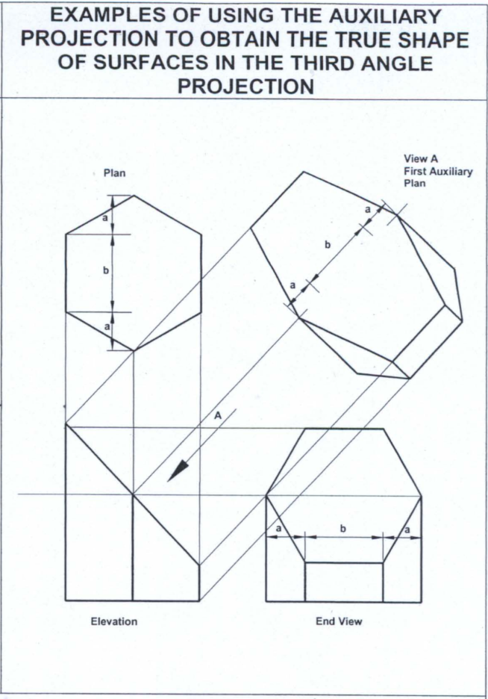
Example
- Third Angle
- First Auxiliary Plan
Features:
- Projection before the Object
- Perpendicular to Elevation View Projection

Slide 32
Example
- Third Angle
- First Auxiliary Elevation
Features:
- Projection before the Object
- Perpendicular to Plan View Projection

Slide 33
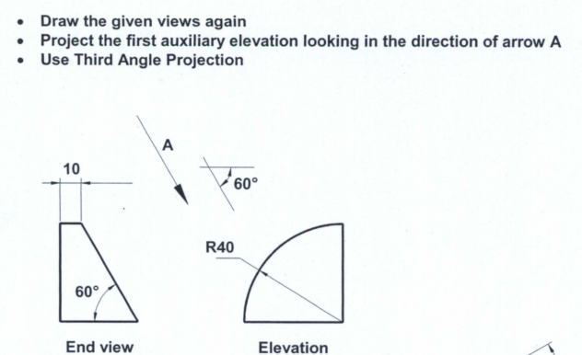
EXAMPLE 1

Slide 34
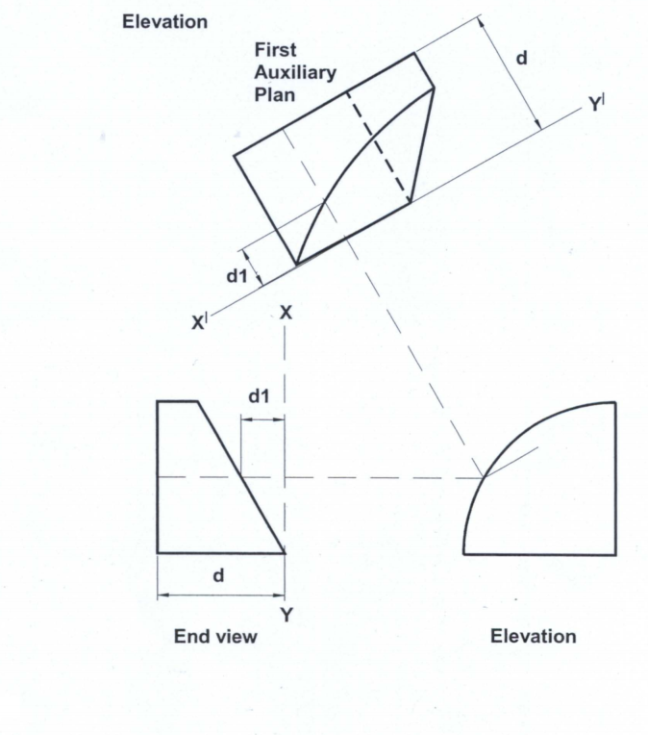
EXAMPLE 1

Slide 35
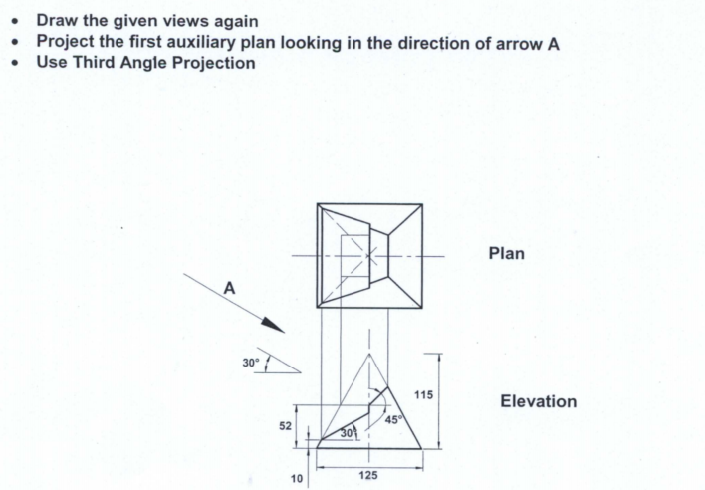
EXAMPLE 2

Slide 36
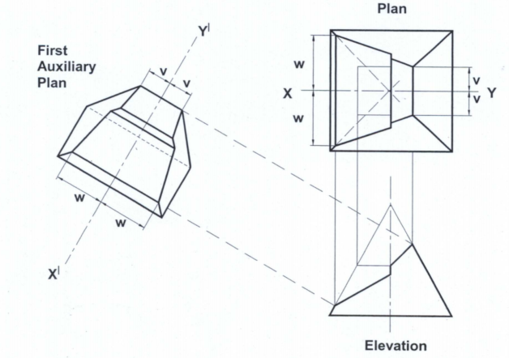
EXAMPLE 2

Slide 37
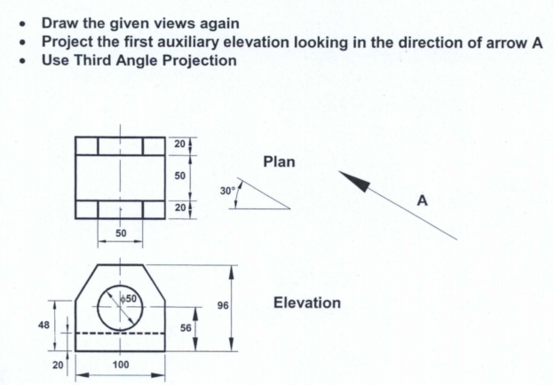
EXAMPLE 3

Slide 38
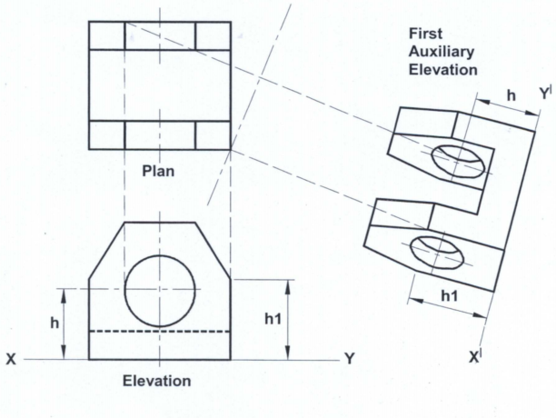
EXAMPLE 3
hidden line missed!

Slide 39
EXAMPLE 3

Slide 40
SCAN TO DOWNLOAD THE SLIDES

Slide 41
WEEK 6 - AUXILIARY PROJECTION

Slide 42
AUXILIARY PROJECTION - PRECEDURES
1. Reproduce the principal views
2. Projectors parallel to the given direction from end points
3. Ground line perpendicular to the projectors
4. Transfer heights/widths

Slide 43
AUXILIARY PROJECTION – CURVES APPROXIMATION
How many points ? Up to you
Rule of thumb

Slide 44
AUXILIARY PROJECTION – FURTHEST POINTS

Slide 45

AUXILIARY PROJECTION – EDGE OF COLUMNS

Slide 46

AUXILIARY PROJECTION – HIDDEN LINES
CMD - Break

Slide 47
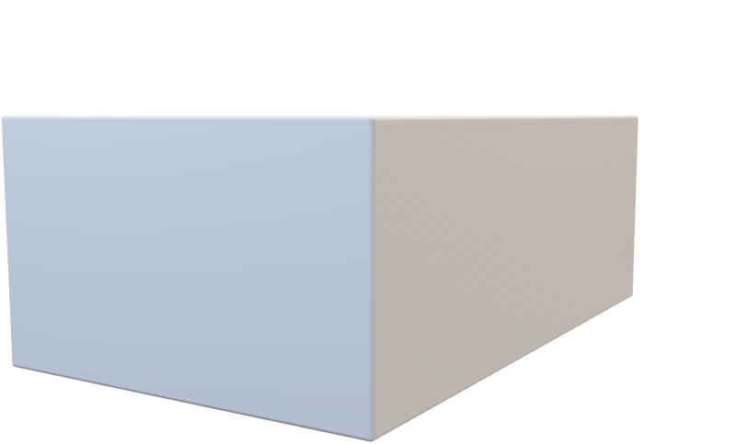
AUXILIARY PROJECTION – HIDDEN LINES

Slide 48
QUIZ
SEATING – Every Other Column
QUIZ PAPER (cannot be taken out) – Write down Name + Matr.No.
NO INTERNET CONNECTION, ONLY NTULearn Access
DWG + PDF – Learn how to export them

Slide 49
SCAN TO DOWNLOAD THE SLIDES

Slide 50
WEEK 8 – BIM & Autodesk Revit Basics
Building Information Modeling (BIM)
BIM is an intelligent digital process that uses 3D models enriched with multidisciplinary data to support the planning, design, construction, and lifecycle management of buildings and infrastructure, enabling collaboration, efficiency, and informed decision-making across stakeholders.
Autodesk Revit
Autodesk Revit is the most widely used BIM software, enabling architects, engineers, and construction professionals to collaboratively design, visualize, and manage building projects across their lifecycle.

Slide 51
WEEK 8 – BIM & Autodesk Revit Basics
Following NTLearn and Linkedin videos to learn Revit basic operations
Submit R1-4 by the end of week 8.

Slide 52
SCAN TO DOWNLOAD THE SLIDES

